Slide 1
The requested quad chart is on the next slide. Please read the following notes before completing.
Please do not remove the headers; problem, benefits and technology solution.
The more text you put into each box, the smaller the text will be. Be mindful that this quad chart will be printed on half of an 8.5”x11” piece of paper and smaller text will make it difficult to read.
The information you insert should be relative to the technology that you’re bringing to the event to showcase.
Once complete, please save this file with a title that includes your company name, so that we can distinguish which belongs to you.

Slide 2
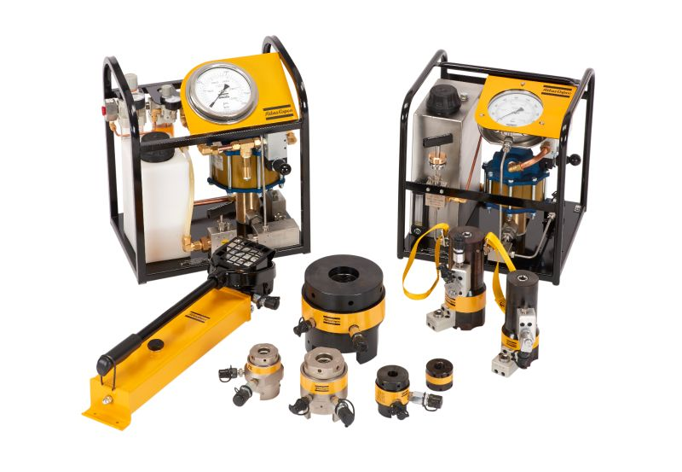
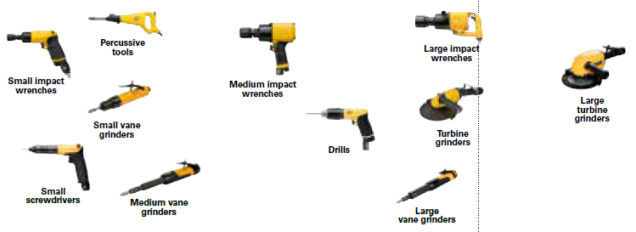
Productivity issues
Quality / Re-work costs
Ergonomic tooling problems
Reliability concerns
High cycle times
PROBLEM
Less noise and vibration
Less trigger time exposure to the operator
Improved productivity and quality
Data collection
Lubrication free motors
BENEFITS
Hydraulic nuts vs. supper nuts
Data collection for torqueing bolts vs. second operation inspection
Speed governor for continues power
Scatter damping for less vibration
High power-to-weight ratio
Auto balancer to minimize vibration
TECHNOLOGY SOLUTION

